Slide 1
Springboot Application Using Cassandra
Athulya Vijayan
245283

Slide 2
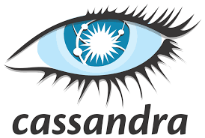
What Is Cassandra
Cassandra is a free and open-source distributed NoSQL database.
Designed to handle large volumes of data across multiple data centers .
Written in Java and originally developed by Facebook.
Cassandra offers many advantages which other NoSQL databases .
Providing high availability and scalability.

Slide 3
Features Of Cassandra
Supports horizontal scaling.
High availability and reliability.
Distributed and supports data replication .
Can handle huge amount of data.
Has its own query language - Cassandra Query Language(CQL).

Slide 4
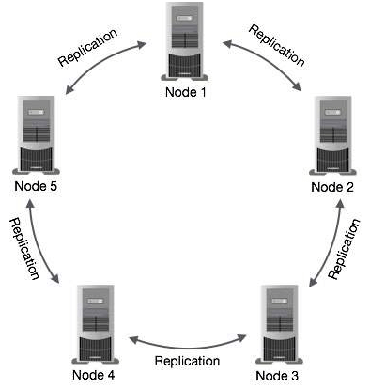
Cassandra Architecture

Slide 5
In Cassandra, each node is independent and at the same time interconnected to other nodes. All the nodes in a cluster play the same role.
Every node in a cluster can accept read and write requests, regardless of where the data is actually located in the cluster.
In the case of failure of one node, Read/Write requests can be served from other nodes in the network.

Slide 6
Advantages of Cassandra
It’s open-source
Cassandra can be easily scaled up or down.
It features data replication, so it’s fault-tolerant and has high availability.
It follows peer-to-peer architecture rather than master-slave architecture, so there isn’t a single point of failure.

Slide 7
Disadvantages of Cassandra
It doesn’t support ACID and relational data properties
Cassandra doesn’t support aggregate functions.
It offers no join or subquery support
Cassandra uses its own query language called CQL (Cassandra Query Language), which is similar to SQL but has some differences and limitations.

Slide 8
References
https://github.com/10-06-2000/SpringBoot-Cassandra1
https://www.youtube.com/watch?v=E4jzcOuB39o

